Slide 1
Bucharest University of Economic Studies
Cybernetics, Statistics and Economic Informatics
Developing a Fully Homomorphic Encryption WebAssembly module
Easy
FHE
GRADUATE
PREDA MIHAIL IRINEL
COORDINATOR
LECTURER PH.D. ANDREI TOMA

Slide 2
OBJECTIVE
Creating a library that could be easily used on the web, while making fully homomorphic encryption concepts more accessible.

Slide 3
SUMMARY
01
02
INTRODUCTION
USED TECHNOLOGIES
03
04
ARCHITECTURE
DEMO
05
06
RESULTS
CONCLUSIONS

Slide 4

INTRODUCTION
Every day, we create roughly 2.5 million terabytes. Around 9% is private information, meaning 225000 terabytes. The processing cost is immense.
Imagine if was something that could safely process all this data…

Slide 5
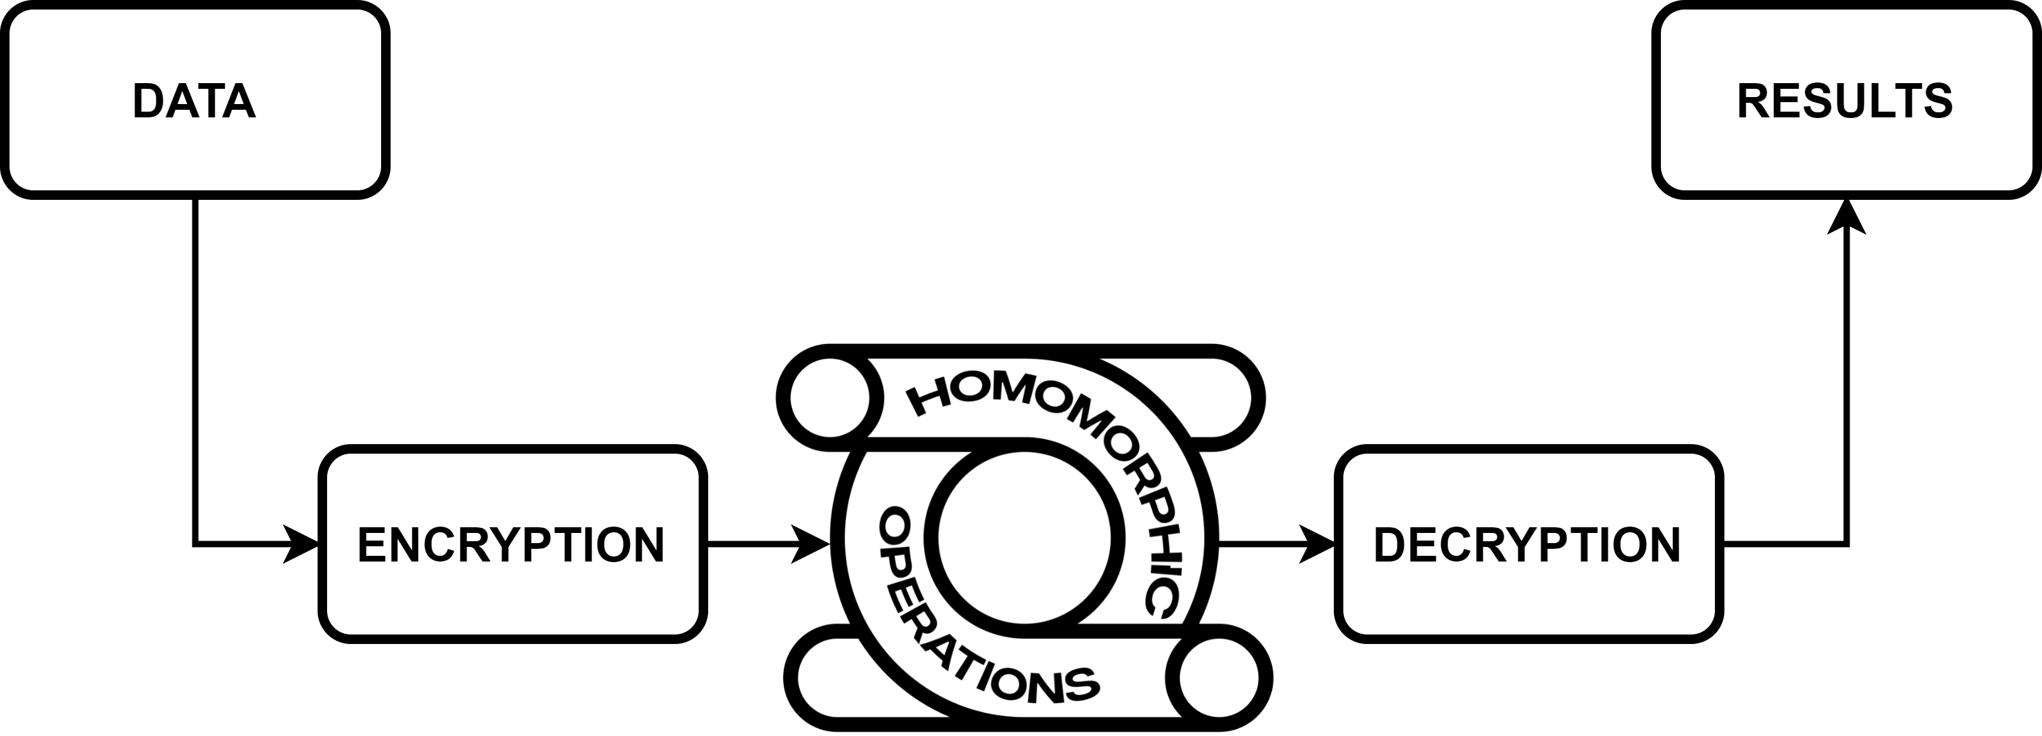
INTRODUCTION

Slide 6






USED TECHNOLOGIES
Microsoft
SEAL
Easy
FHE
node
SEAL

Slide 7
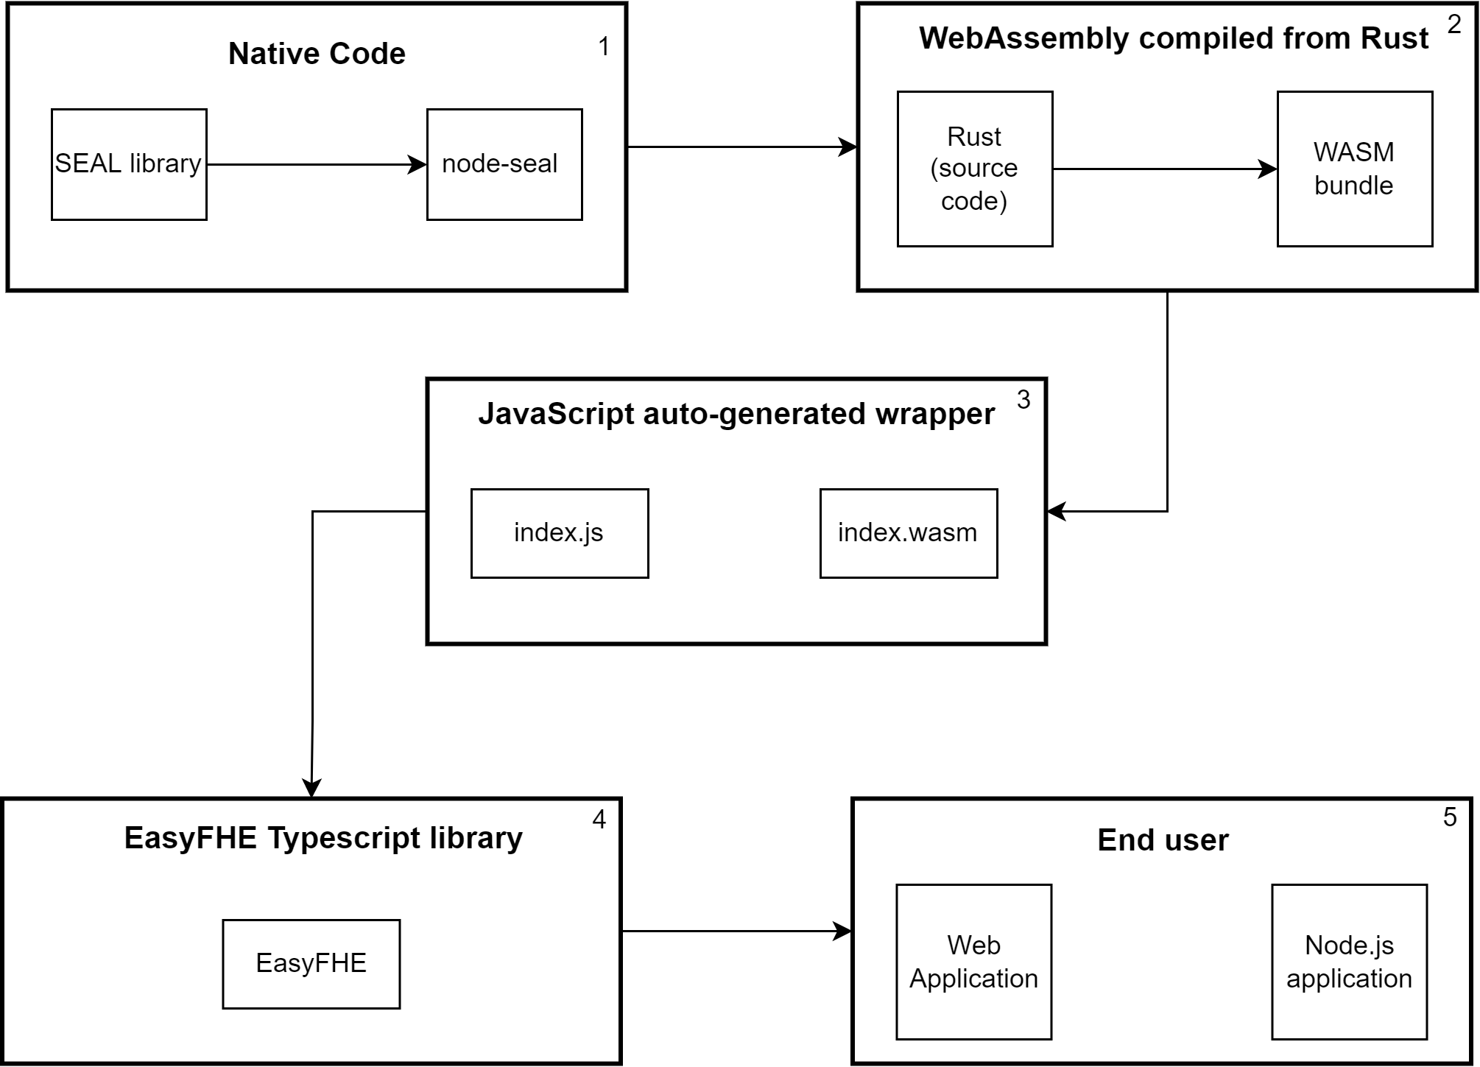
ARCHITECTURE

Slide 8
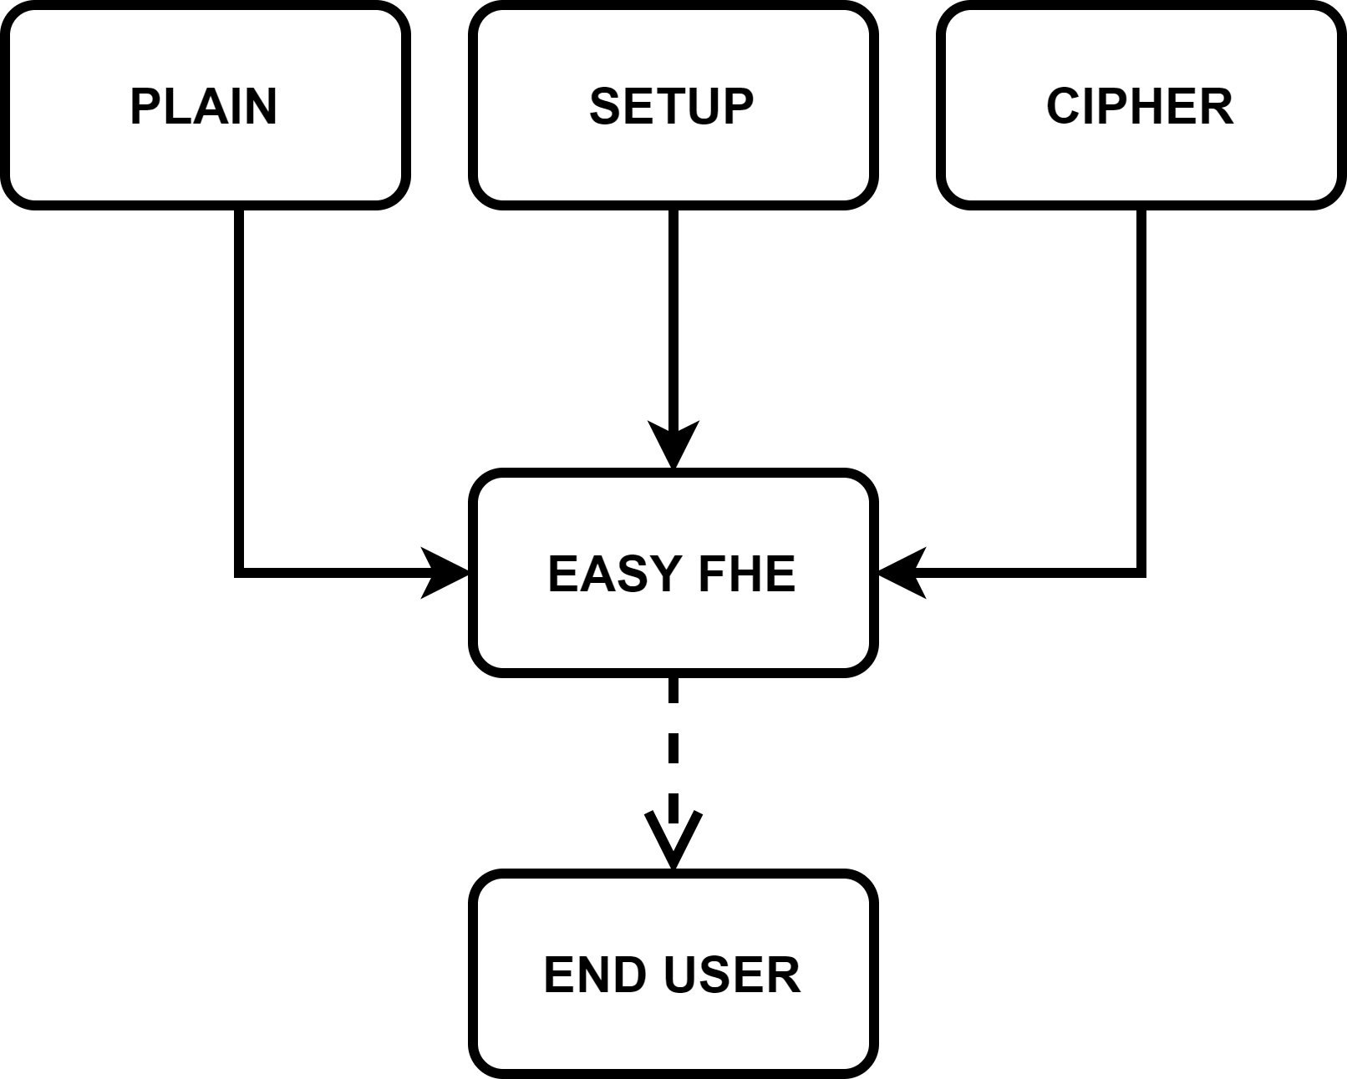
ARCHITECTURE

Slide 9

DEMO
MENU
ENCRYPTION SCHEME SETTINGS
Home
Getting started
Brakerski/Fan-Vercauteren scheme
INPUTS
Playground
Security: 128 bits
Speed: normal
Precision: normal
DECRYPTED RESULT
GitHub
Plaintext
Ciphertext
Plaintext
Ciphertext
3, 4, 7, 2, 1
+
1, 2, 5, 7, 8
=
4, 6, 12, 9, 9
Plaintext
Ciphertext
Plaintext
Ciphertext
R3VymZTg/Go...
+
1, 2, 5, 7, 8
q5V5hvsUW…
PROCESSED
INPUTS
=
Compute
Decrypt
ENCRYPTED RESULT
Add operation
Code comparison
Delete scheme
+
ADD SCHEMES
SCHEME
DASHBOARD

Slide 10
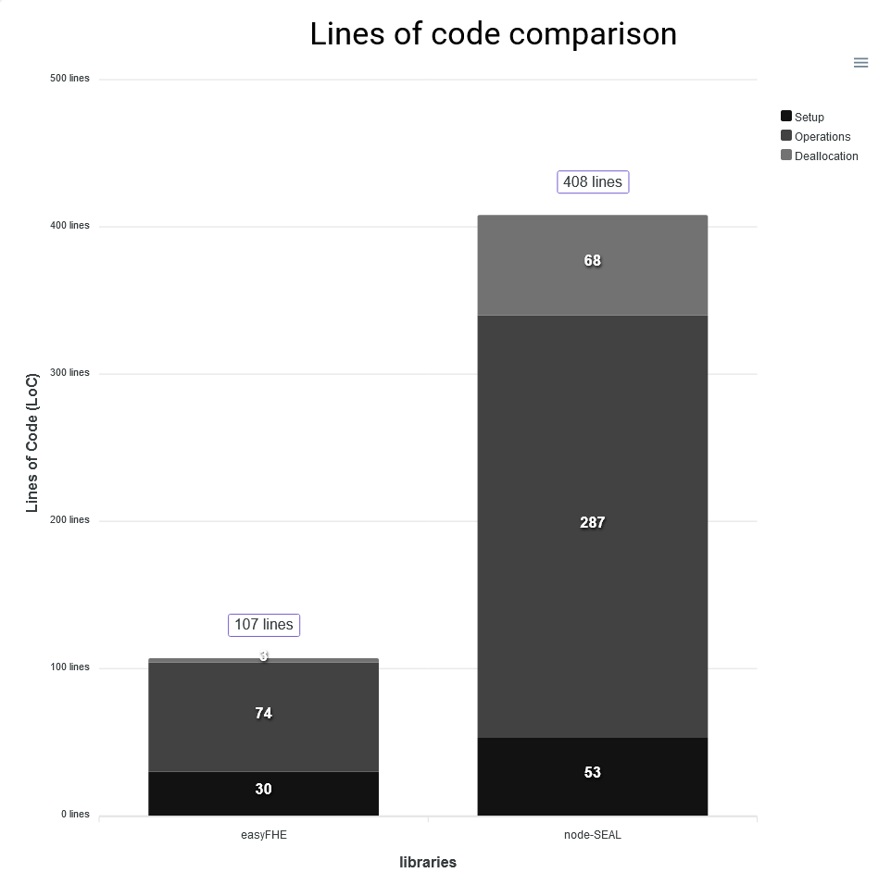
RESULTS
From a developer’s perspective, source code written using EasyFHE is on average 26.22% from the node-SEAL equivalent or almost 4 times more compact.

Slide 11
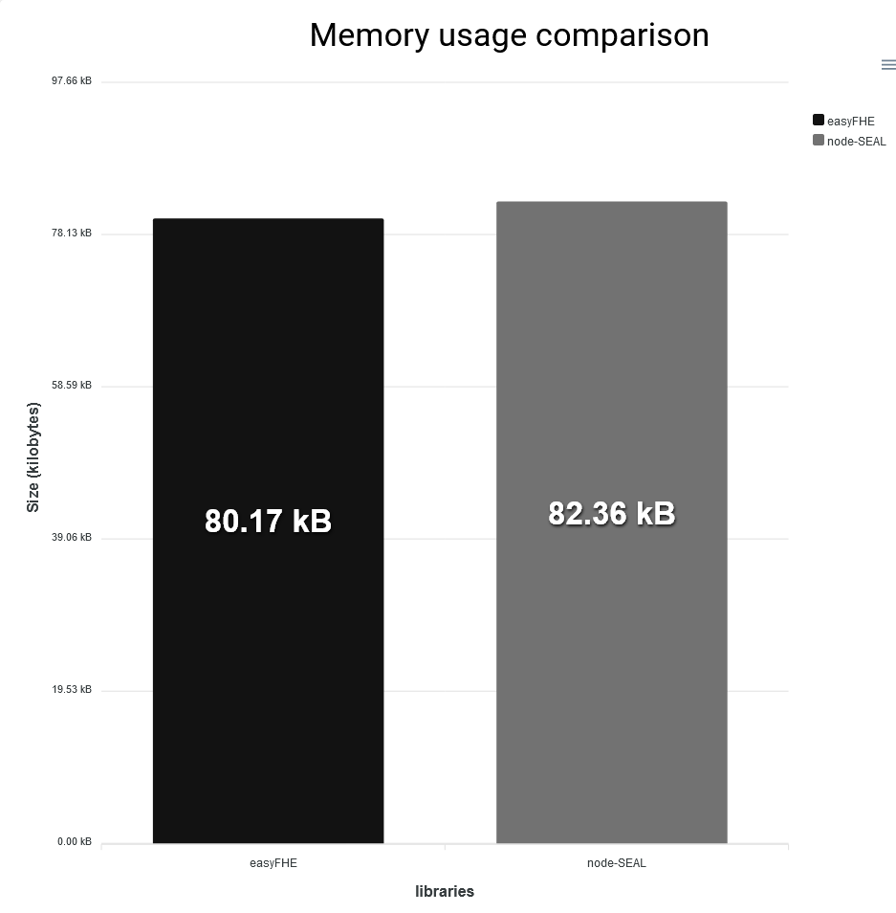
RESULTS
EasyFHE module uses on average with 2.73% less RAM memory due to applied optimizations.

Slide 12
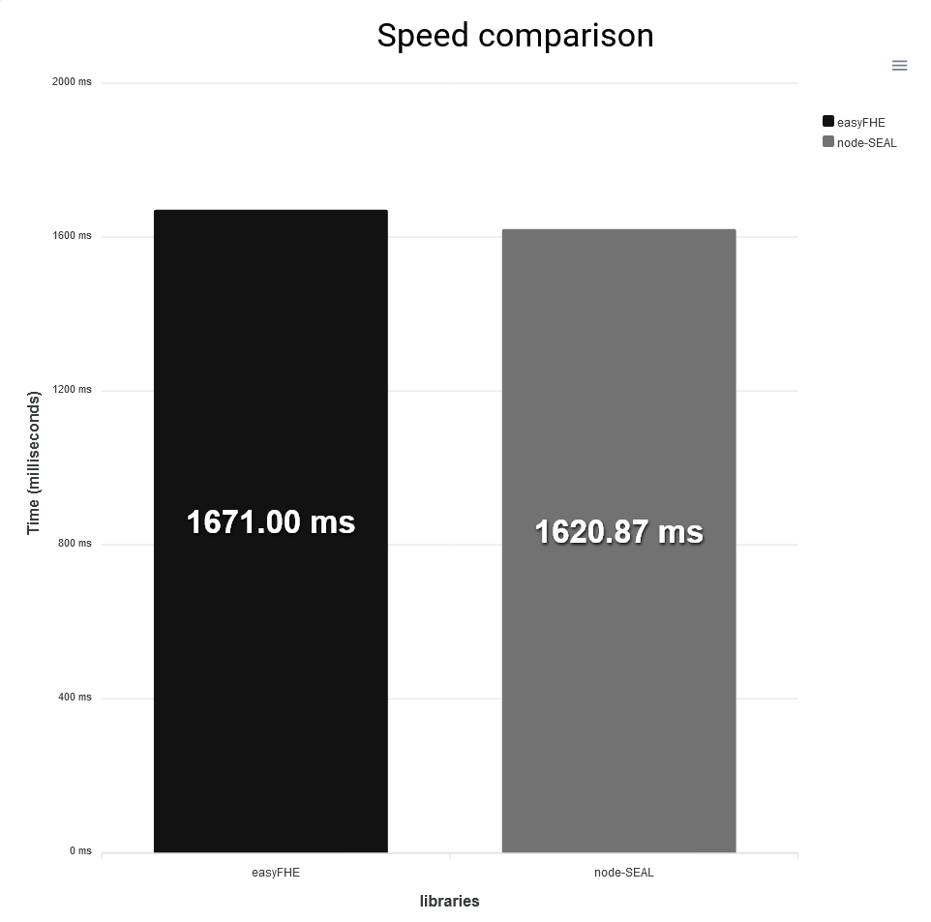
RESULTS
EasyFHE is on average with 3.09% slower than the node-SEAL counterpart.

Slide 13
CONCLUSIONS
It is developer friendly.
EasyFHE offers a compressed alternative, with simplified and safe APIs implemented in Typescript.

Slide 14
CONCLUSIONS
It is Plug & Play.
EasyFHE it is designed with interoperability in mind, being compatible with websites and Node.js applications.

Slide 15
CONCLUSIONS
It is efficient.
It uses the resources intelligently, offering a reduced memory footprint.

Slide 16

Q&A
Preda Mihail Irinel
mihaipreda1997@gmail.com

